Slide 1



Blanked Out Books
Can you guess the book title and author from our cleverly disguised covers?
Have a guess then click next to reveal the answer!

Slide 2


Blanked Out Books

Slide 3


Blanked Out Books

Slide 4
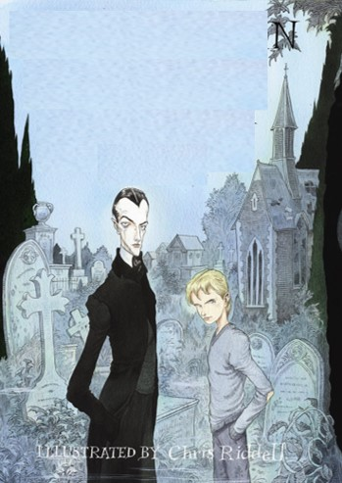
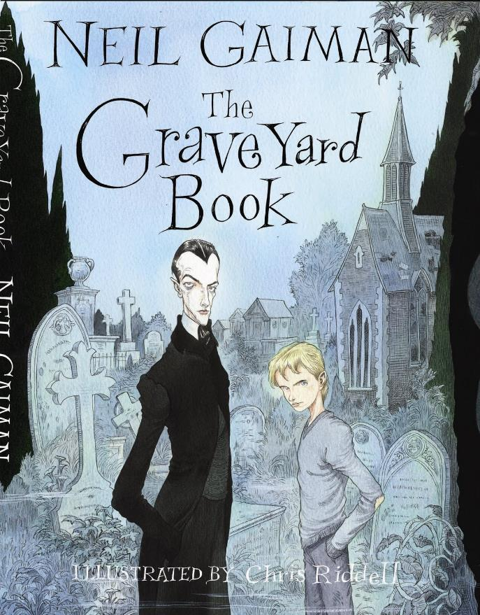
Blanked Out Books

Slide 5

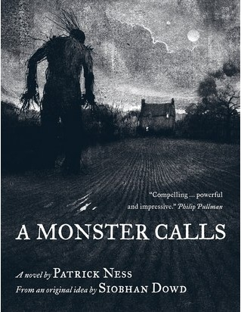
Blanked Out Books

Slide 6


Blanked Out Books

Slide 7


Blanked Out Books

Slide 8



Blanked Out Books

Slide 9
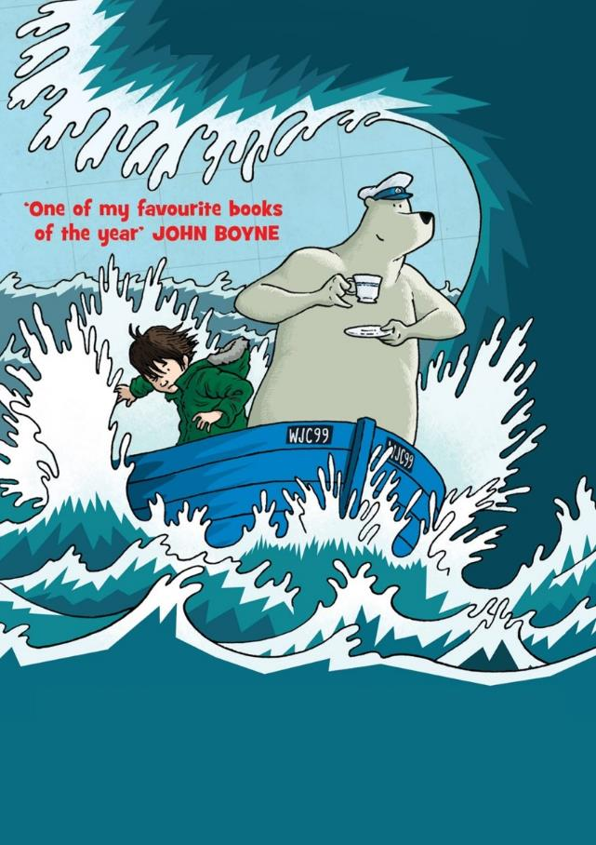

Blanked Out Books

Slide 10
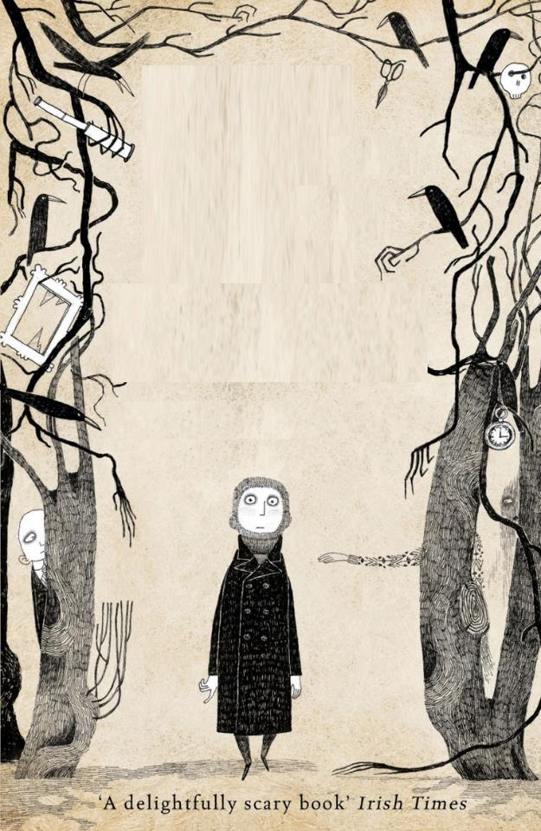

Blanked Out Books

Slide 11
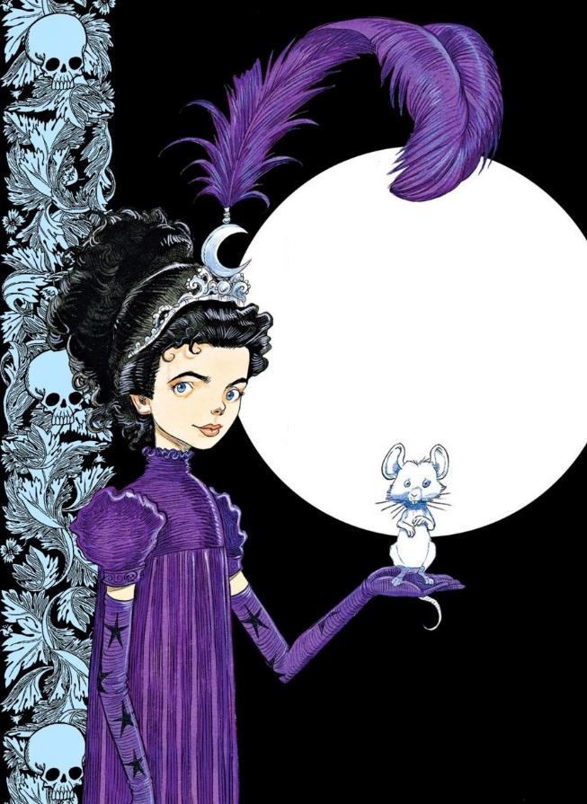
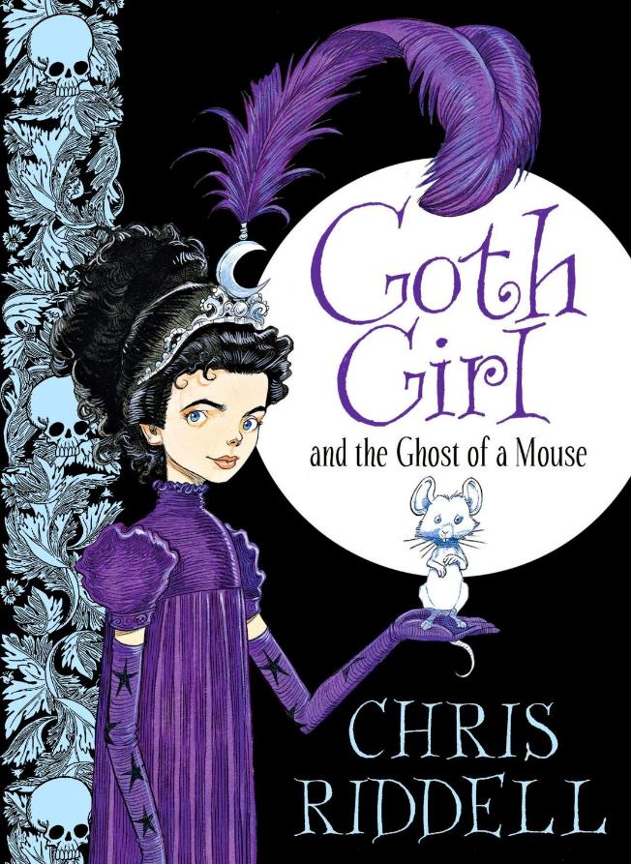
Blanked Out Books

Slide 12


Blanked Out Books

Slide 13

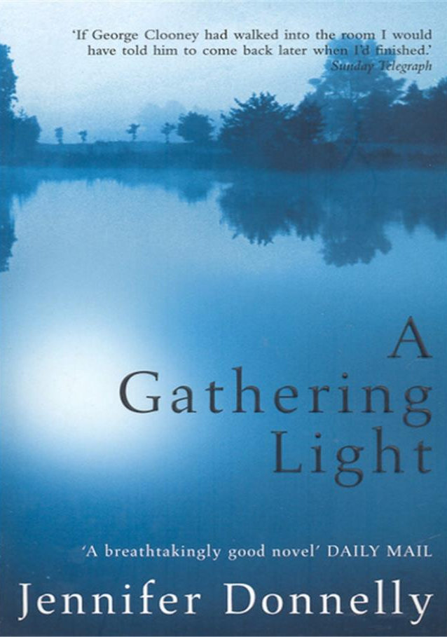
Blanked Out Books

Slide 14


Blanked Out Books

Slide 15


Blanked Out Books

Slide 16


Blanked Out Books

Slide 17


Blanked Out Books

Slide 18


Blanked Out Books

Slide 19


Blanked Out Books

Slide 20



Blanked Out Books

Slide 21


Blanked Out Books

Slide 22



Slide 23


Blanked Out Books

Slide 24


Blanked Out Books

Slide 25
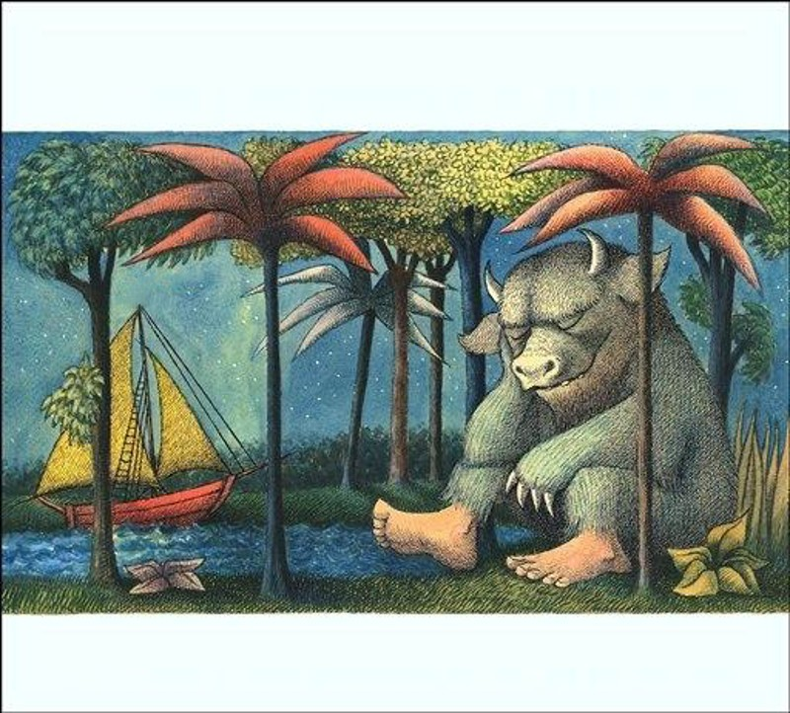

Blanked Out Books

Slide 26


Blanked Out Books

Slide 27


Blanked Out Books

Slide 28


Blanked Out Books

Slide 29
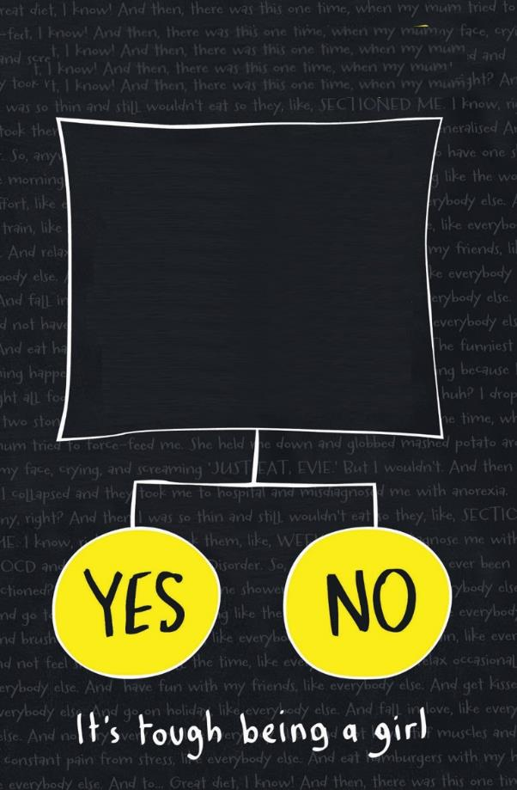

Blanked Out Books

Slide 30

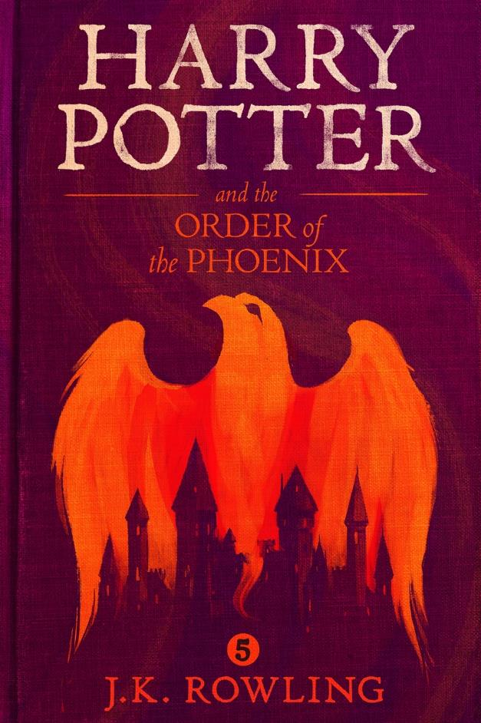
Blanked Out Books

Slide 31

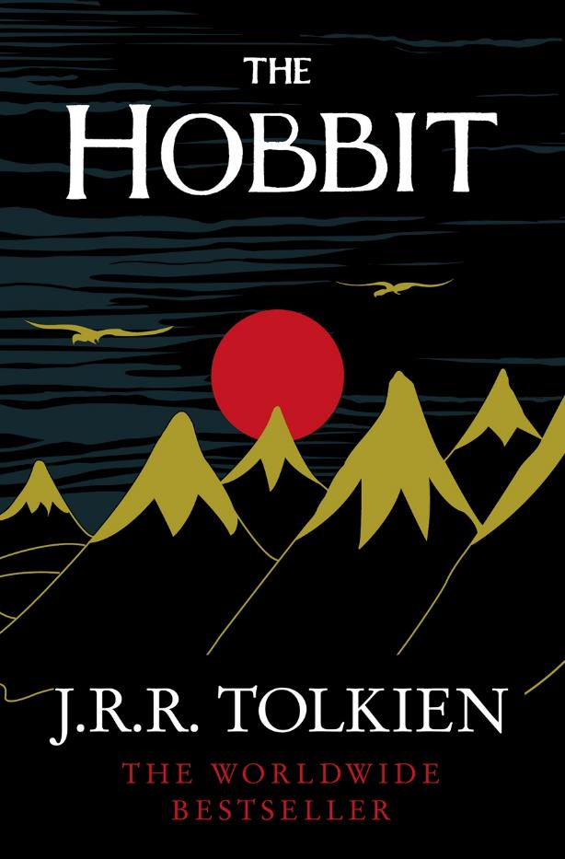
Blanked Out Books

Slide 32
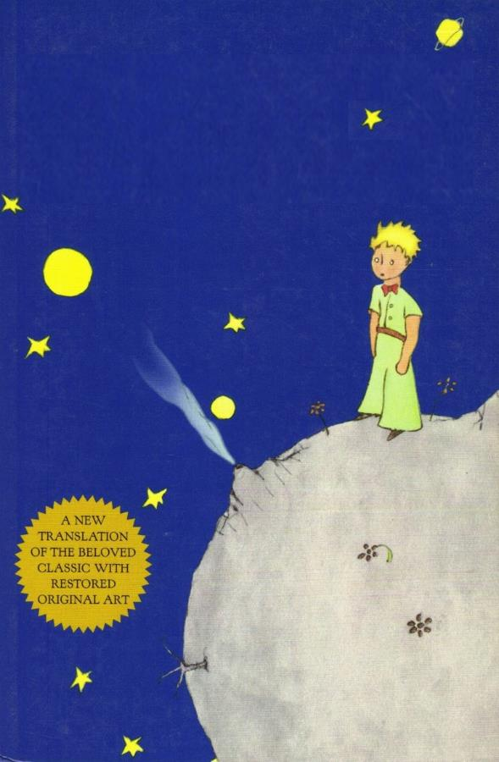

Blanked Out Books

Slide 33
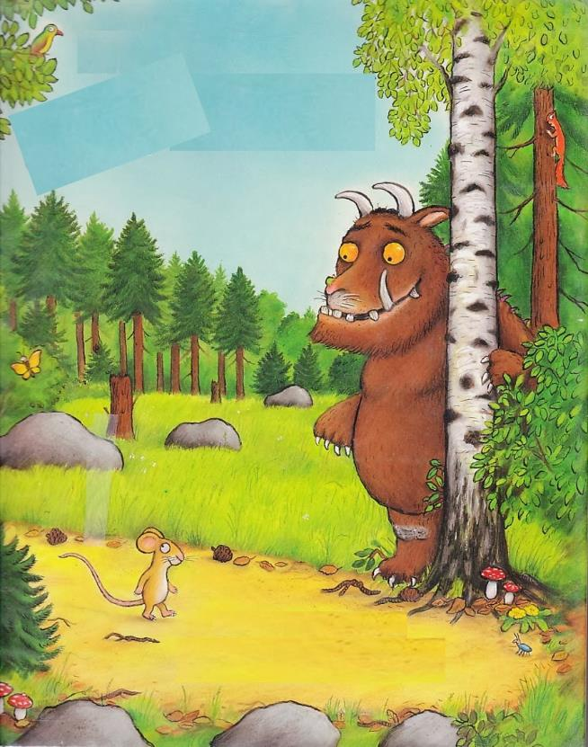

Blanked Out Books

Slide 34


Blanked Out Books

Slide 35
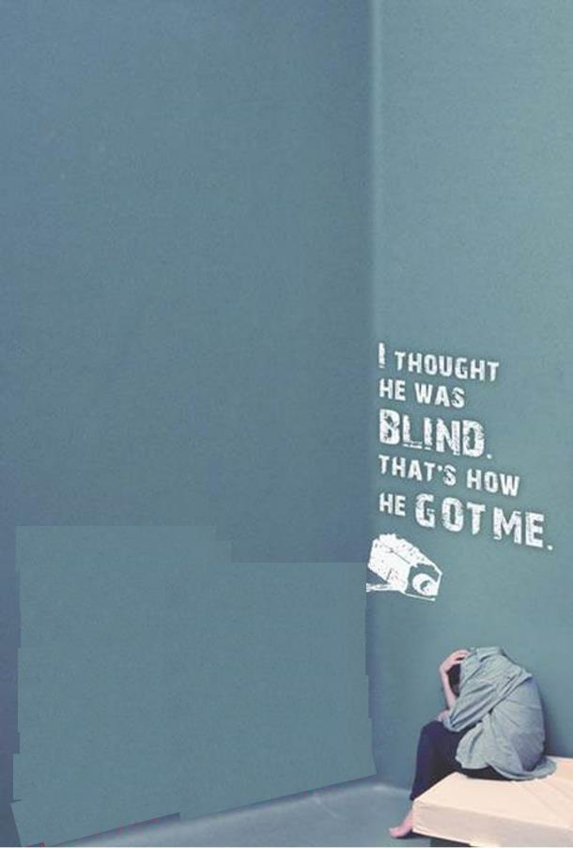

Blanked Out Books

Slide 36

How did you do?

